Slide 1




AtliQ Hardwares
Consumer Goods Ad-Hoc Insights
Made by – Protyoy Pritam Goswami

Slide 2

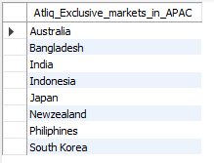
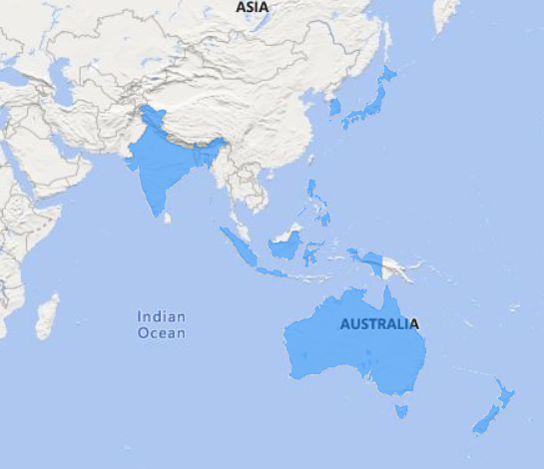
Insight #1 Atliq Exclusive markets in APAC region

